Slide 1
Artificial Intelligence __Search Techniques
By DR Geeta Chhabra Gandhi

Slide 2
1. What is Artificial Intelligence
the simulation of human intelligence processes by machines,
especially computer systems

Slide 3
Artificial Intelligence
Artifical
Artificial Intelligence
Machine Learning is a subset of Artificial Intelligence
Machine Learning
Deep Learning uses neural networks to simulate human like decision making
Deep Learning
Deep Learning
is a subset of
Machine Learning
Notes:
There are many tools and approaches that have been developed to help get us closer to the goal of artificial intelligence, but some of them have been getting much more attention recently A couple of terms you tend to hear in combination with Artificial Intelligence these days is Machine Learning and Deep Learning.
These are methods and tools used in developing applications of Artificial Intelligence. Let’s look at them a bit more in depth

Slide 4
AI _Search Techniques
In Artificial Intelligence, Search techniques are universal problem-solving methods.
Rational agents or Problem-solving agents in AI mostly used these search strategies or algorithms to solve a specific problem and provide the best result.

Slide 5
Aritificial Intelligence___Search Techniques
Artificial Intelligence is the study of building agents that act rationally.
Most of the time, these agents perform some kind of search algorithm in the
background in order to achieve their tasks.
The objective of a search algorithm is to reach to the goal state from
wherever they are . i.e . To solve a search problem

Slide 6
What is a search Algorithm
one of the most important areas of Artificial Intelligence
Search Algorithms are the search techniques which are being utilized as a universal problem solving method in different areas of Artificial algorithms .

Slide 7
AI Search problem __Search algorithm
A search problem consists of:
A State Space. Set of all possible states where you can be.
A Start State. The state from where the search begins.
A Goal Test. A function that looks at the current state returns whether or not it is the goal state.
The Solution to a search problem is a sequence of actions, called the plan that transforms the start state to the goal state.
This plan is achieved through search algorithms.

Slide 8
Properties of Search Algorithms
Completeness: A search algorithm is said to be complete if it guarantees to return a solution if at least any solution exists for any random input.
Optimality: If a solution found for an algorithm is guaranteed to be the best solution (lowest path cost) among all other solutions, then such a solution for is said to be an optimal solution.
Time Complexity: Time complexity is a measure of time for an algorithm to complete its task.
Space Complexity: It is the maximum storage space required at any point during the search, as the complexity of the problem.

Slide 9
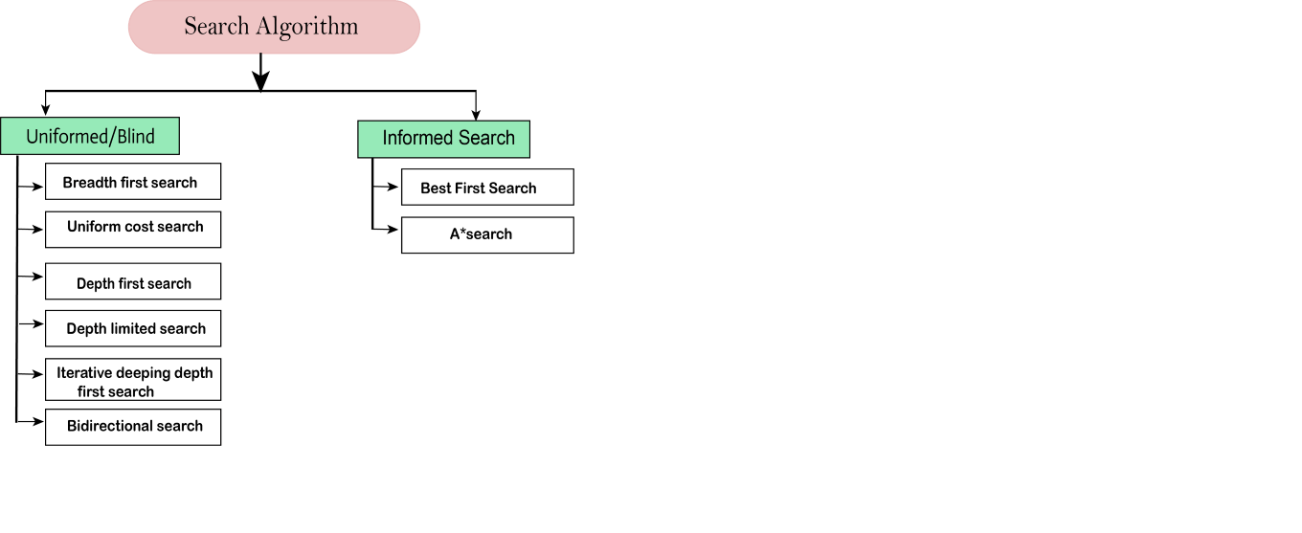
Types of Search Algorithms

Slide 10
1. The Uninformed search Algorithms
The uninformed search does not contain any domain knowledge such as closeness, the location of the goal.
2. only includes information about how to traverse the tree and how to identify leaf and goal nodes.
3. without any information about the search space like initial state operators and test for the goal
4. Also called BLIND SEARCH

Slide 11
Types of Uninformed search / Blind Search
It can be divided into five main types:
Breadth-first search
Uniform cost search
Depth-first search
Iterative deepening depth-first search
Bidirectional Search

Slide 12
2. Informed Search Algorithms
use domain knowledge
problem information is available which can guide the search.
can find a solution more efficiently
also called a Heuristic search.
contains an array of knowledge such as how far we are from the goal, path cost, how to reach to goal node, etc.
This knowledge help agents to explore less to the search space and find more efficiently the goal node.

Slide 13
Informed Search Algorithms
Greedy Search(Best First Search Algorithm )
A* Search
Ao* Search

Slide 14
Heuristic Function / Informed searched
It expands nodes based on their heuristic value h(n). It maintains two lists, OPEN and CLOSED list. In the CLOSED list, it places those nodes which have already expanded and in the OPEN list, it places nodes which have yet not been expanded.
On each iteration, each node n with the lowest heuristic value is expanded and generates all its successors and n is placed to the closed list. The algorithm continues until a goal state is found.

Slide 15
UNINFORMED SEARCH ALGORITHMS

Slide 16
Outline
Learning Goals
Uninformed Search
Breadth-First Search
Depth-First Search
Comparing the algorithms

Slide 17
Learning goals
By the end of the lecture, you should be able to
Describe what it means to expand a node and what is a frontier in a search tree.
Define/trace/implement search algorithms (with/without cost) (dealing with repeated states)
Define completeness, optimality, time complexity and space complexity.
Determine properties of search algorithms: completeness, optimality, time and space complexity.
Given a scenario, explain why it is appropriate or not appropriate to use a particular search algorithm.

Slide 18
Terminologies
A search tree: the nodes are the states, the arcs are actions, and the root is the start state.
Expanding a node means applying every legal action to the current state to generate a set of new states.
The frontier contains the set of all leaf nodes available for expansion.

Slide 19
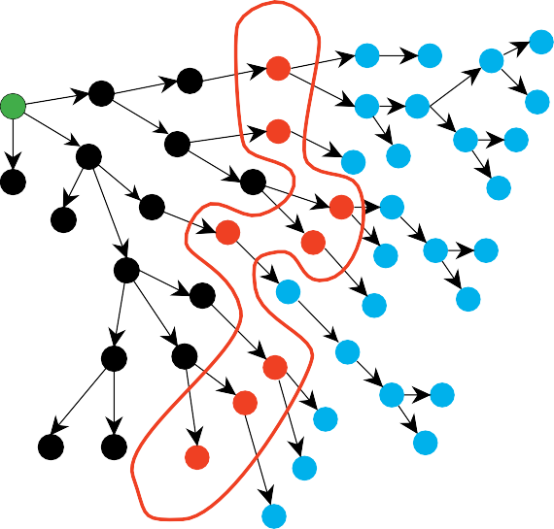
Problem Solving by Graph Searching
frontier
start node
explored nodes
unexplored nodes

Slide 20
Graph Search Algorithm
Algorithm 1 Generic graph search algorithm
1: put the start state in the frontier
2: while frontier is not empty do
3: remove a node from the frontier
4: if the node contains a goal state then
5: return the solution
6: end if
7: generate all the successors of the node
8: add every successor of the node to the frontier
9: end while
10: return failure

Slide 21
The Search Strategy
Search strategy: which node do we remove from the frontier?
Breadth-first search treats the frontier as a queue (FIFO).
Depth-first search treats the frontier as a stack (LIFO).
Informed search treats the frontier as a priority queue.

Slide 22
Breadth First Search Algorithm
Uninformed Search

Slide 23
Breadth First Search An approach to frame the problems of AI in graphs
starts by searching a start node, followed by its adjacent nodes.
BFS algorithm visits all vertices in a graph GG that are kk edges away from the source vertex ss before visiting any vertex k+1, k+1 edges away.
This is done until no more vertices are reachable from ss

Slide 24
Working of Breadth first Search Algorithm

Slide 25
Breadth-First Search
Algorithm 2 Breadth-First Search
1: put the start state in the frontier
2: while frontier is not empty do
3: remove the oldest node added to the frontier
4: if the node contains a goal state then
5: return the solution
6: end if
7: generate all the successors of the node
8: add every successor of the node to the frontier
9: end while
10: return failure

Slide 26
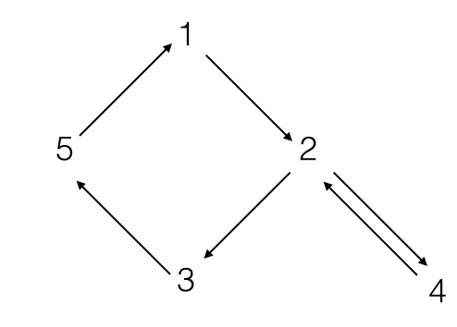
Use the breadth first strategy to traverse the graph below
1, 4, 5, 3, 2
1, 2, 3, 5, 4
1, 2, 4, 3, 5
1, 3, 5, 4, 2
Choose the correct option

Slide 27
Explanation
Correct answer: 1, 2, 4, 3, 5
After visiting a vertex vv, the breadth-first search strategy of graph traversal visits every vertex adjacent to vv that it can. Thus, the traversal will not embark from any of the vertices adjacent to vv until it has visited all possible vertices adjacent to vv. BFS is a first visited, first explored strategy.
The path taken for the graph will thus be 1 -> 2 -> 4 -> 3 -> 5

Slide 28
Depth First Search Algorithm
Uninformed Search

Slide 29
Depth-first search (DFS): An approach to frame the problems of AI in graphs
is an algorithm for searching a graph or tree data structure.
The algorithm starts at the root (top) node of a tree and goes as far as it can down a given branch (path), then backtracks until it finds an unexplored path, and then explores it.
The algorithm does this until the entire graph has been explored.
Many problems in computer science can be thought of in terms of graphs.
For example, analyzing networks, mapping routes, scheduling, and finding spanning trees are graph problems.
To analyze these problems, graph-search algorithms like depth-first search are useful.

Slide 30
Working of Depth first Search Algorithm

Slide 31
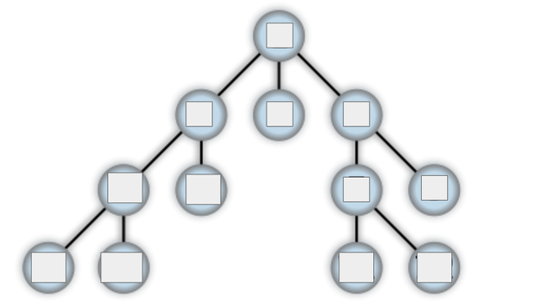
Fill out the following graph by labeling each node 1 through 12 according to the order in which the depth-first search would visit the nodes

Slide 32
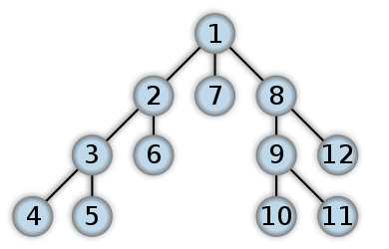
DFS __Example

Slide 33
Depth-First Search
Algorithm 3 Depth-First Search
1: put the start state in the frontier
2: while frontier is not empty do
3: remove the newest node added to the frontier
4: if the node contains a goal state then
5: return the solution
6: end if
7: generate all the successors of the node
8: add every successor of the node to the frontier
9: end while
10: return failure

Slide 34
Depth-First Search (DFS) Problems:
Number of Islands: Count the number of islands in a 2D grid map, utilizing DFS. Problem Link
Word Search: Determine if a word exists in a 2D board, using DFS. Problem Link
Symmetric Tree: Check if a binary tree is symmetric using DFS. Problem Link
Path Sum: Determine if the given sum exists in a binary tree, using DFS. Problem Link
Binary Tree Level Order Traversal: Perform level order traversal on a binary tree using DFS.

Slide 35
Why Depth-First Search is Important
The depth-first search has a wide range of use cases.
Solving a maze or puzzle
Scheduling a problem
Cycle detection in a graph
Network analysis
Mapping routes
Topological sorting
The depth-first search is also the base for many other complex algorithms.

Slide 36
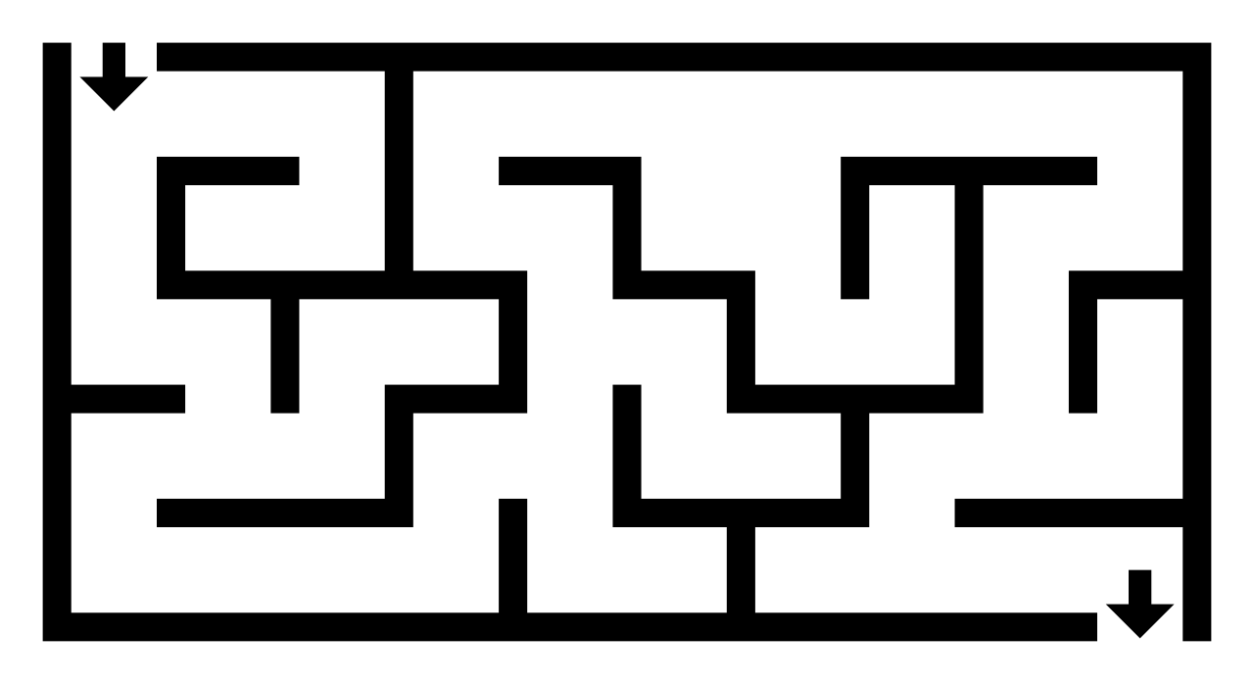
DFS Algorithm __Solving a MAZE

Slide 38
BFS and DFS
A comparison

Slide 39
Evaluating an Algorithm’s Performance
Definition (complete)
If a solution exists, a complete algorithm is
guaranteed to find a solution within a finite amount of time.
Definition (optimal)
If a solution exists and an algorithm finds a solution, then the first solution found by an optimal algorithm is the solution with the lowest cost.

Slide 40
Evaluating an Algorithm’s Performance
Definition (time complexity)
The time complexity of a search algorithm is an expression for the worst-case amount of time it will take to run,
expressed in terms of b, d, and m.
Definition (space complexity)
The space complexity of a search algorithm is an expression for the worst-case amount of memory that the algorithm will use, expressed in terms of b, d, and m.
Useful definitions:
b: the maximum branching factor (may be infinite).
d: the depth of the shallowest goal node (finite).
m: the maximum path length (may be infinite).

Slide 41
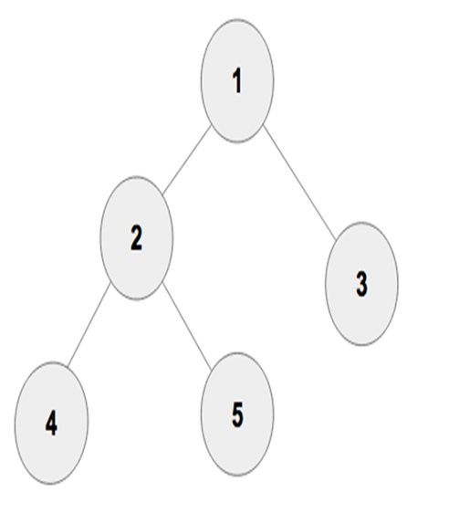
BFS always returns an optimal answer, but this is not guaranteed for DFS
Here is an example that compares the order that the graph is searched in when using a BFS and then a DFS (by each of the three approaches).^{[2]}
Breadth First Search : 1 2 3 4 5
Depth First Search
Pre-order: 1 2 4 5 3
In-order : 4 2 5 1 3
Post-order : 4 5 2 3 1

Slide 42
The best of BFS and DFS
BFS | DFS
requires lots of space | requires little space
complete | not complete
The best of both worlds:
Run DFS until level l.
If no solution found, try level l + 1, l + 2, etc.

Slide 43
INFORMED SEARCH ALGORITHMS

Slide 44
ADVERSARIAL SEARCH TECHNIQUES

Slide 45
Adversarial Search
where we examine the problem which arises when we try to plan ahead of the world and other agents are planning against us.
multi-agent environment, in which each agent is an opponent of other agent and playing against each other
Searches in which two or more players with conflicting goals are trying to explore the same search space for the solution, are called adversarial searches,

Slide 46
Adversarial Search Algorithm
Adversarial search is a search when
there is an "enemy" or "opponent" changing the state of the problem every step in a direction you do not want.
You change state, but then you don't control the next state.
Opponent will change the next state in a way: unpredictable.
Examples: Chess, business, trading, war

Slide 47
Formalization of the problem:__Adversarial Search
A game can be defined as a type of search in AI which can be formalized of the following elements:
Initial state: It specifies how the game is set up at the start.
Player(s): It specifies which player has moved in the state space.
Action(s): It returns the set of legal moves in state space.

Slide 48
Formalization of the problem:__Adversarial Search
Result(s, a): It is the transition model, which specifies the result of moves in the state space.
Terminal-Test(s): Terminal test is true if the game is over, else it is false at any case. The state where the game ends is called terminal states.
Utility(s, p): A utility function gives the final numeric value for a game that ends in terminal states s for player p. It is also called payoff function. For Chess, the outcomes are a win, loss, or draw and its payoff values are +1, 0, ½. And for tic-tac-toe, utility values are +1, -1, and 0.

Slide 49
Informed Search Algorithms
Informed Search signifies that the algorithm has extra information, to begin with. For example, an uninformed search problem algorithm would be finding a path from home to work completely blind.
On the flip-side, an informed search problem algorithm would be finding a path from home to work with the aid of your sight (seeing what path brings you closer to your destination) or a map (knowing exactly how far away every single point is from your destination).

Slide 50
A* Algorithm
informed Search

Slide 51
Basic Concepts of A*
A* is based on using heuristic methods to achieve optimality and completeness and is a variant of the best-first algorithm.
When a search algorithm has the property of optimality, it means it is guaranteed to find the best possible solution, in our case the shortest path to the finish state. When a search algorithm has the property of completeness, it means that if a solution to a given problem exists, the algorithm is guaranteed to find it.
Each time A* enters a state, it calculates the cost, f(n) (n being the neighboring node), to travel to all of the neighboring nodes, and then enters the node with the lowest value of f(n).

Slide 52
Basic Concepts of A*
These values are calculated with the following formula:
f(n)=g(n)+h(n)
g(n) being the value of the shortest path from the start node to node n, and h(n) being a heuristic approximation of the node's value.
The efficiency of A* is highly dependent on the heuristic value h(n), and depending on the type of problem, we may need to use a different heuristic function for it to find the optimal solution.
A* Search finds the shortest path between two points by efficiently exploring possible routes. It uses a heuristic to estimate the distance to the goal and prioritizes paths that seem most promising.
It is a widely used pathfinding and graph traversal algorithm known for its efficiency and accuracy in finding the shortest path between two points.

Slide 53
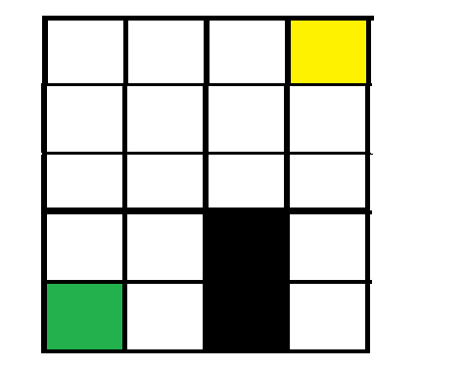
Use A* to find the shortest path from the green square to the yellow square in the grid below.

Slide 54
Given cost and heuristic value

Slide 55
Example Explanation:
In this either MIN wins, MAX wins, or it's a draw. This game-tree is the whole search space of possibilities that MIN and MAX are playing tic-tac-toe and taking turns alternately.
Hence adversarial Search for the minimax procedure works as follows:
It aims to find the optimal strategy for MAX to win the game.
It follows the approach of Depth-first search.
In the game tree, optimal leaf node could appear at any depth of the tree.
Propagate the minimax values up to the tree until the terminal node discovered.

Slide 56
A* Algorithm
Applications: Widely used in various applications, including:
Robotics
Games
Maps
Navigation systems
Resource planning

Slide 57
The A* search algorithm has several important properties −
Completeness: A* is complete, meaning it will always find a solution if one exists.
Optimality: A* is optimal, meaning it will find the shortest path to the goal if the heuristic used is admissible (i.e., it never overestimates the true cost to reach the goal).
Efficiency: A* is efficient, especially when the heuristic is well-designed, as it reduces the number of nodes that need to be explored.

Slide 58
Steps of A* Search Algorithm
The A* search algorithm proceeds in the following steps −
Step 1: Initialize: Initialize the open list with the start node and the closed list as empty. The open list contains nodes to be evaluated, while the closed list contains nodes that have already been evaluated.
Step 2: Select Node: Select the node with the lowest f value (f = g + h) from the open list and move it to the closed list.
Step 3: Check Goal: If the selected node is the goal node, reconstruct the path and return it as the solution.
Step 4: Expand Node: For each neighbor of the selected node, calculate its g, h, and f values. If the neighbor is not in the open list, add it. If it is already in the open list with a higher f value, update its f value and parent node.
Step 5: Repeat: Repeat steps 2 to 4 until the open list is empty or the goal node is found.

Slide 59
Complexity of A* Search Algorithm
The time and space complexity of the A* search algorithm depends on the heuristic used −
Time Complexity: In the worst case, A* has a time complexity of O(b^{d}), where b is the branching factor and d is the depth of the shortest path. The efficiency of A* improves with better heuristics.
Space Complexity: A* has a space complexity of O(b^{d}) as it needs to store all the nodes in memory. Memory usage can be a limiting factor for large graphs.

Slide 60
Algorithm A* Algorithm
A* Search Algorithm 1. Initialize the open list 2. Initialize the closed list put the starting node on the open list (you can leave its f at zero) 3. while the open list is not empty a) find the node with the least f on the open list, call it "q" b) pop q off the open list c) generate q's 8 successors and set their parents to q

Slide 61
d) for each successor i) if successor is the goal, stop search ii) else, compute both g and h for successor successor.g = q.g + distance between successor and q successor.h = distance from goal to successor (This can be done using many ways, we will discuss three heuristics- Manhattan, Diagonal and Euclidean Heuristics) successor.f = successor.g + successor.h iii) if a node with the same position as successor is in the OPEN list which has a lower f than successor, skip this successor iV) if a node with the same position as successor is in the CLOSED list which has a lower f than successor, skip this successor otherwise, add the node to the open list end (for loop)

Slide 62
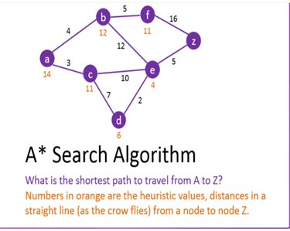
Solve the graph using A* Algorithm

Slide 63
AO* Algorithm
informed Search

Slide 64
AO* _basic Concepts
The AO algorithm* (short for “And-Or Star”) is a powerful best-first search method used to solve problems that can be represented as a directed acyclic graph (DAG). Unlike traditional algorithms like A*, which explore a single path, the AO* algorithm evaluates multiple paths simultaneously. This makes it more efficient for problems that involve AND-OR nodes. The AND nodes represent tasks where all child nodes must be satisfied, while OR nodes offer multiple alternative paths where only one child node needs to be satisfied to achieve the goal.

Slide 65
Working Principles of AO* Algorithm
The AO* algorithm works by utilizing a tree structure where each node represents a state in the problem space. The key components of the algorithm are:
Node Types
AND Nodes: Represent states where all child nodes must be satisfied to achieve a goal. If a task requires multiple conditions to be met, it would be represented as an AND node.
OR Nodes: Represent states where at least one child node must be satisfied to achieve a goal. This type is useful in scenarios where multiple paths can lead to a solution.

Slide 66
Heuristic Function
The algorithm employs a heuristic function, similar to A*, to estimate the cost to reach the goal from any given node. This function helps in determining the most promising paths to explore. The heuristic function h(n)h(n) estimates the cost to reach the goal from node nn:
h(n)=estimated cost to reach the goal from node h(n)=estimated cost to reach the goal from node

Slide 67
Search Process
The search begins at the initial node and explores its child nodes based on the type (AND or OR). The costs associated with nodes are calculated using the following principles:
For OR Nodes: The algorithm considers the lowest cost among the child nodes. The cost for an OR node can be expressed as:
C(n)=min⁡{C(c1),C(c2),…,C(ck)}C(n)=min{C(c1​),C(c2​),…,C(ck​)}
where C(n)C(n) is the cost of node nn and c1,c2,…,ckc1​,c2​,…,ck​​ are the child nodes of nn.
For AND Nodes: The algorithm computes the cost of all child nodes and selects the maximum cost, as all conditions must be met. The cost for an AND node can be expressed as:

Slide 68
Search Process
C(n)=max⁡{C(c1),C(c2),…,C(ck)}C(n)=max{C(c1​),C(c2​),…,C(ck​)}
where C(n)C(n) is the cost of node nn, and c1,c2,…,ckc1​,c2​,…,ck​​ are the child nodes of nn.
Total Estimated Cost
The total estimated cost f(n)f(n) at any node nn is given by:
f(n)=C(n)+h(n)f(n)=C(n)+h(n)
where:
C(n)C(n) is the actual cost to reach node nn from the start node.
h(n)h(n) is the estimated cost from node nn to the goal.

Slide 69
In summary:
f(n)=Actual cost+Estimated costf(n)=Actual cost+Estimated cost
The search continues recursively until the goal is reached or all possibilities are exhausted.

Slide 70
AO*Algorithm _Steps
algorithm AOStar(Graph, StartNode):
// INPUT
// Graph = the graph to search
// StartNode = the starting node
// OUTPUT
// The minimum cost path from StartNode to GoalNode
CurrentNode <- StartNode

Slide 71
AO* Algo
while there is a new path with lower cost from StartNode to GoalNode:
calculate the cost of path from the current node to the goal node
through each of its successor nodes
if the successor node is connected to other successor nodes by AND-ARCS:
sum up the cost of all paths in the AND-ARC
return the total cost
else:
calculate the cost of the single path in the OR side
return the single cost

Slide 72
AO* algo
find the minimum cost path
CurrentNode <- Successor Node Of Minimum Cost Path
if CurrentNode has no successor node:
do the backpropagation and correct the estimated costs
CurrentNode <- StartNode
return CurrentNode, New estimated costs
else:
return null
return The minimum cost path

Slide 73
AO* Performance
The AO* algorithm is not optimal because it stops as soon as it finds a solution and does not explore all the paths. For example, if the early heuristic value of P(A-C-D) were more than 12, we would never explore this side, and the solution remained for the OR side.
However, AO* is complete, meaning it finds a solution, if there is any, and does not fall into an infinite loop. Moreover, the AND feature in this algorithm reduces the demand for memory.
The space complexity comes in polynomial order, while the time complexity is O(b^m), where b stands for branching and m is the maximum depth or number of levels in the search tree.
The space complexity comes in polynomial order, while the time complexity is O(b^m), where b stands for branching and m is the maximum depth or number of levels in the search tree.

Slide 74
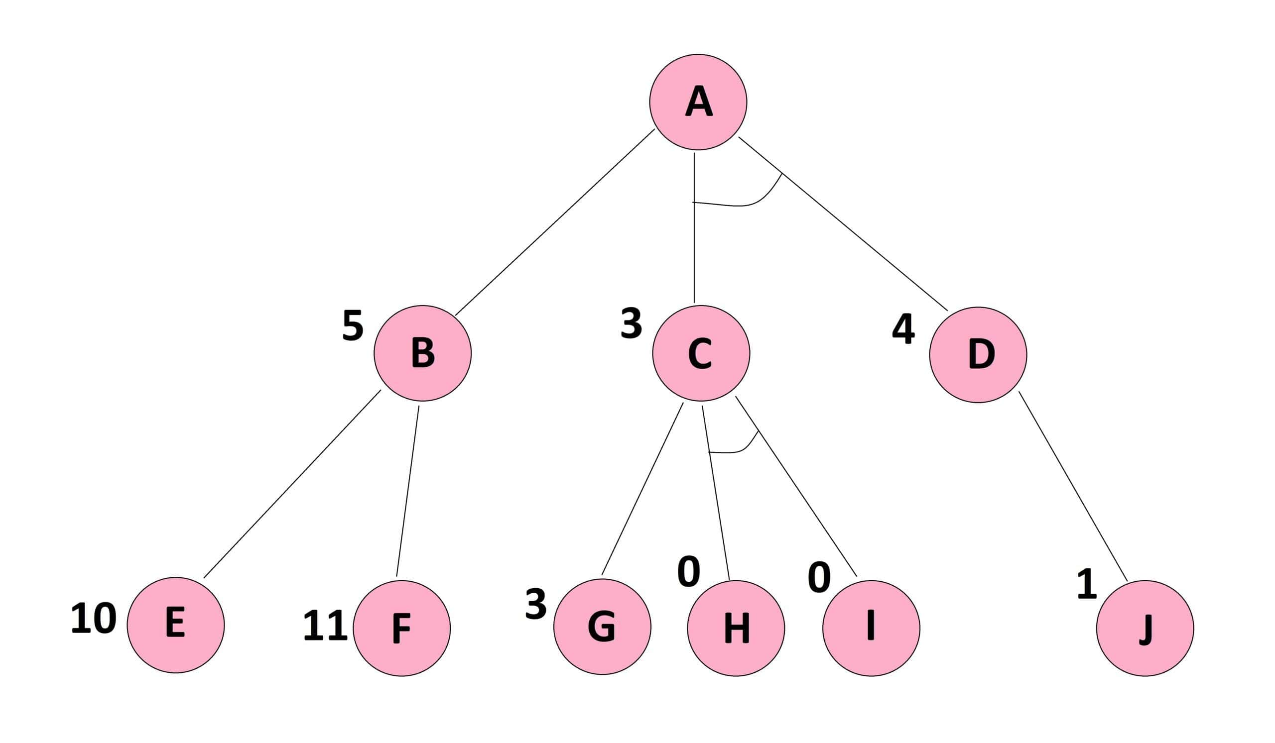
Solve with AO* algorithm

Slide 75
Difference between A* and AO* algorithm
Aspect | A Algorithm* | AO Algorithm*
Search Type | Best-first search | Best-first search
Type of Search | Informed search using heuristics | Informed search using heuristics
Solution Optimality | Always gives the optimal solution | Does not guarantee an optimal solution
Path Exploration | Explores all possible paths | Stops exploring once a solution is found
Memory Usage | Uses more memory | Uses less memory
Endless Loop | May go into an endless loop without proper checks | Cannot go into an endless loop

Slide 76
Thanks

